Slide 1
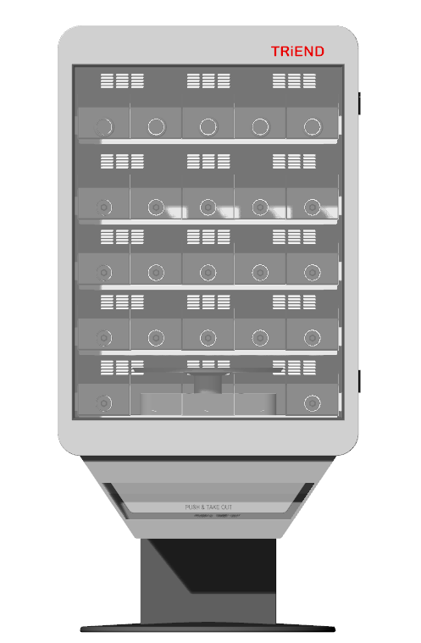
Definitely this looked better
22nd November 2017

Slide 2
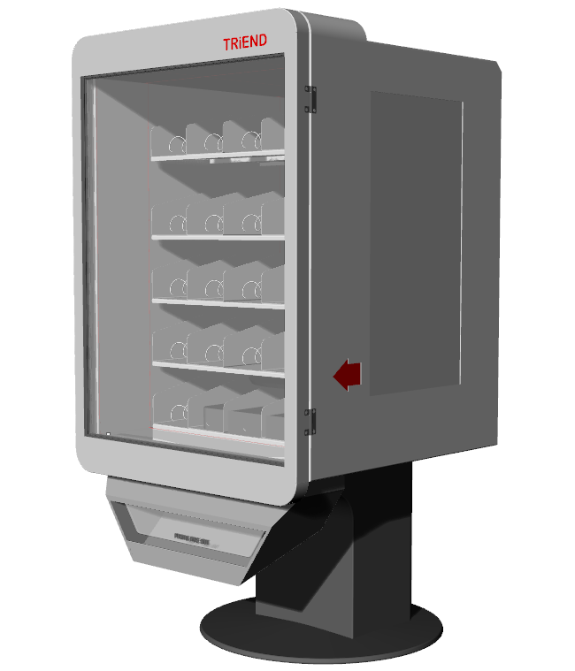
Definitely this looked better with changes base and door bottom profile
22nd November 2017

Slide 3
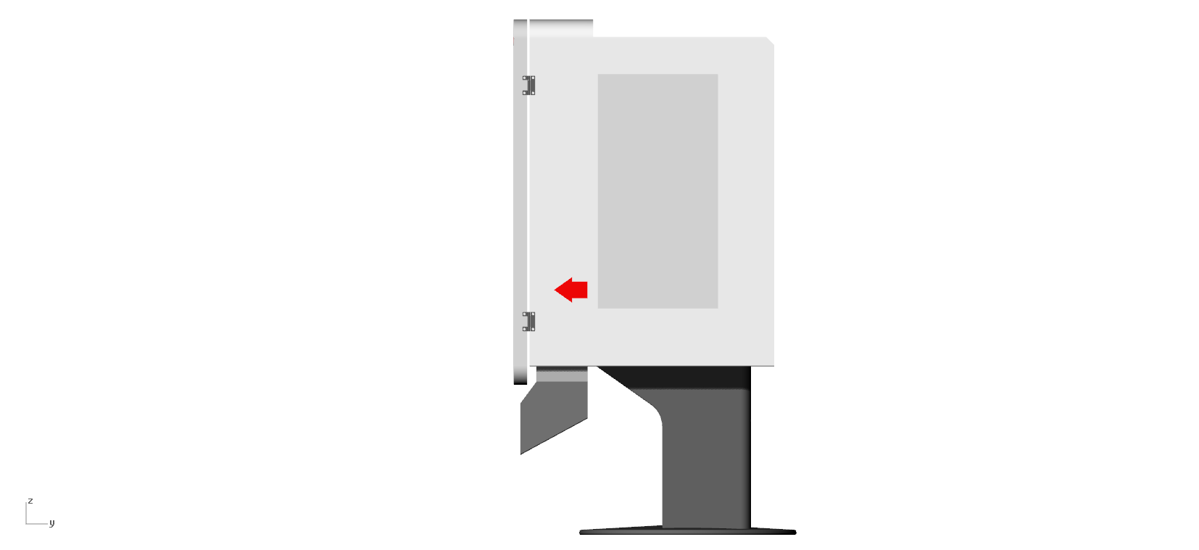
22nd November 2017

Slide 4
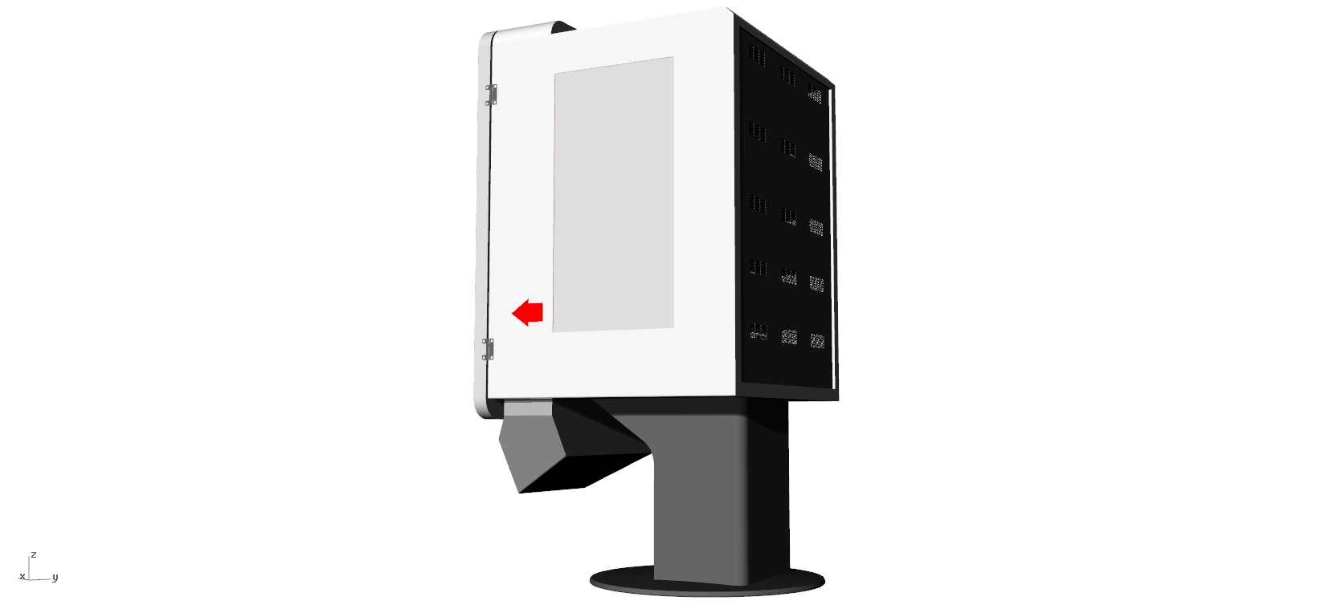
22nd November 2017

Slide 5
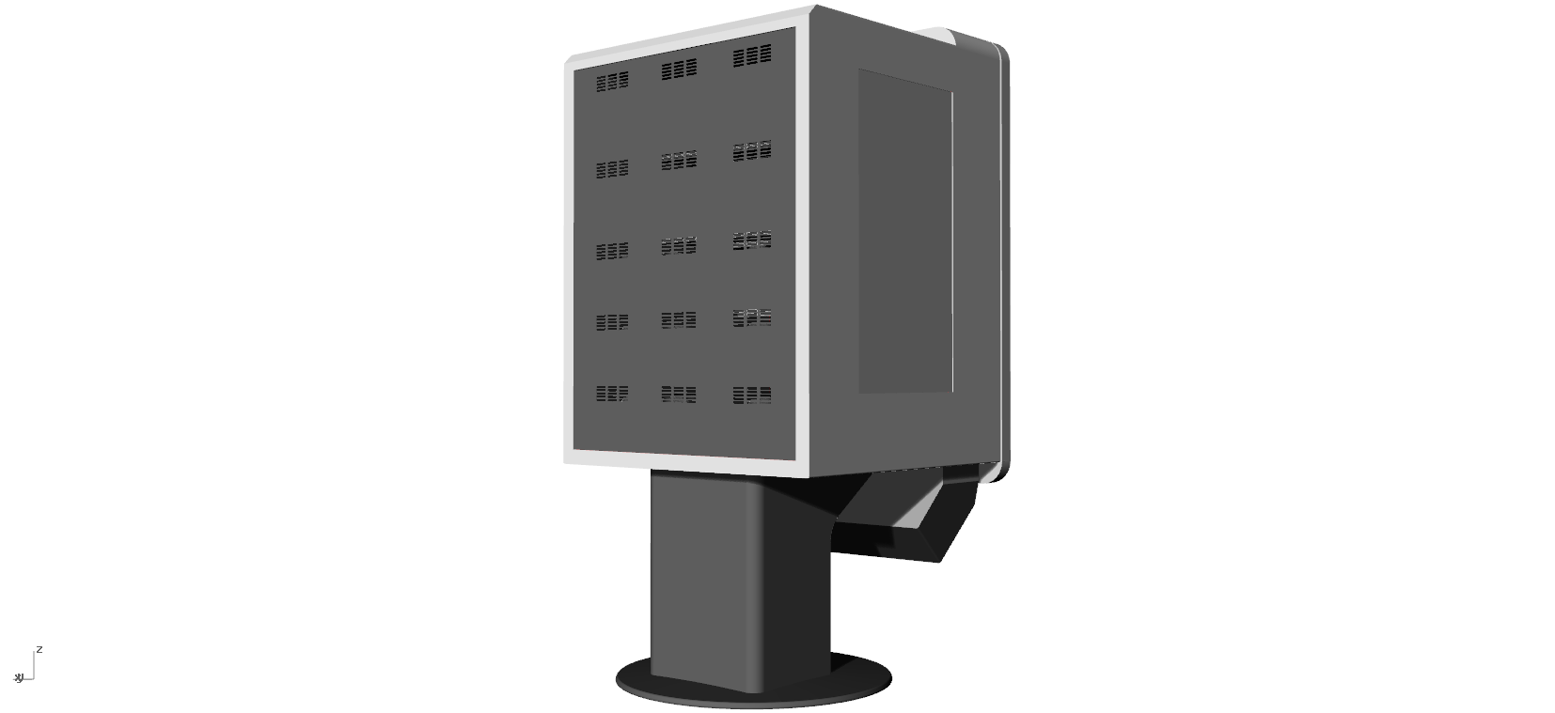
22nd November 2017

